Slide 1
Women Affected by Cancer
By : Karen Larios , Abigail Seaton, Jenna Jeletic, Esther Annor & Iris Reyes

Slide 2
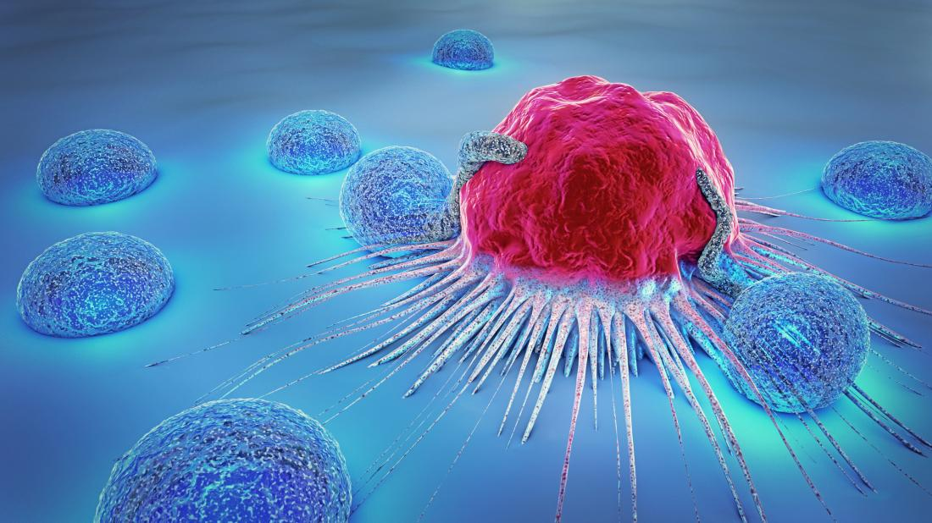


Introduction
CANCER
Notes:
Cancer is a leading cause of death worldwide among women in both high and middle-income countries. Moreover, the cancer burden is expanding in countries of all income levels due to the growth and aging of the population. Some of the risk factors for cancer in women include smoking, excess body weight, physical inactivity, sun exposure, radiation exposure, and changes in reproductive patterns, such as a later age at first childbirth and fewer childbirths.(Lindsey A.et al). Cancer is often times associated with women, due to the high number of women who are often diagnosed with breast cancer at least once throughout their lifetime. The numbers are so high, that there is a breast cancer awareness month every October. Breast cancer is however, not the only type of cancer that affects women in the world, there are many other types of cancer that women suffer severely from. We will delve more deeply into these cancers as we proceed with our presentation.

Slide 3


Objective
Our goal was to use Python as an asset, along with our newly developed coding skills, in order to analyze data about the amounts of women that have been diagnosed with specific types of cancer.

Slide 4

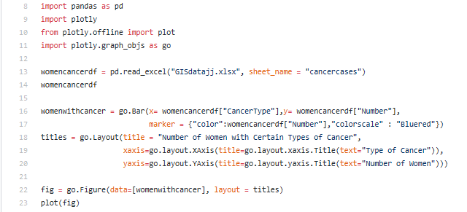
Methodology/Approach
Notes:
Elaborate on using PANDAS, libraries, specific commands (dir, xaxis/yaxis,)
Let’s come up with some other wording because the last sentence should be said but not written on the slide
Hey so i am going to put in a screenshot of our code for that as well

Slide 5
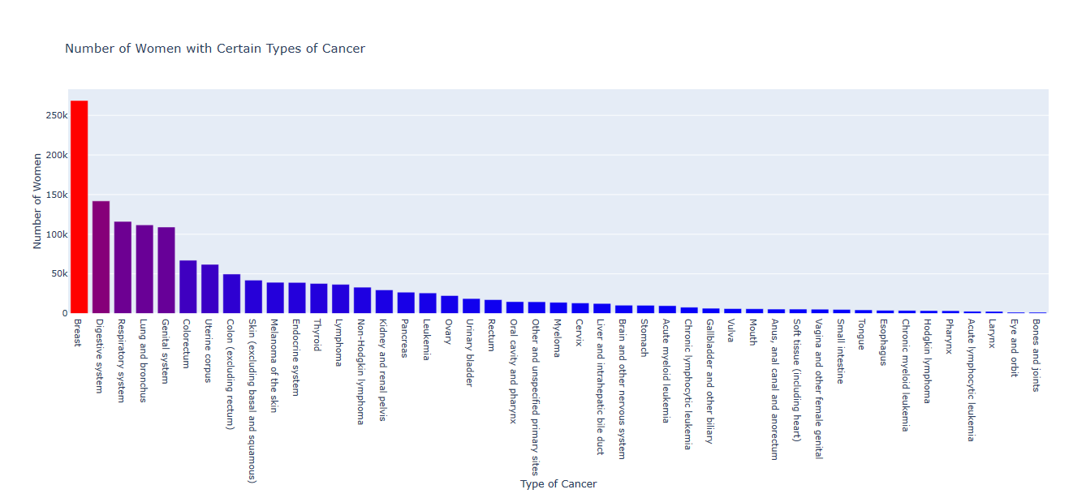
Data Source: American Cancer Society
Notes:
Go to interactive maybe

Slide 6
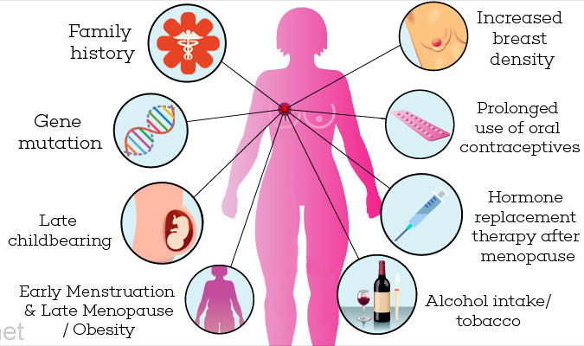

Breast Cancer
About 5 to 10% of breast cancer cases are estimated to be hereditary.
The risks triple if someone in the victim’s family was diagnosed with breast cancer before.
Mutations in the BRCA 1 and BRCA 2 genes are linked to breast cancer.
Information Source:
https://www.nationalbreastcancer.org/causes-of-breast-cancer
https://www.cancer.net/cancer-types/breast-cancer-metastatic/statistics
Notes:
Quick reminder prior, all this data is from 2018
While there are many cancers that women are often diagnosed with, let’s look at the most startling number which is that of breast cancer. INSERT NUMBER. Women’s breasts are on average completely developed by their early teens, if not younger. At that stage, the breasts’ cells are very reactive to hormones and hormone disruptors. These disruptors can cause tumors which increases a woman’s susceptibility to cancer. About 6% of all female breast cancers are metastatic at first diagnosis, which means they can spread to other parts of the body.

Slide 7
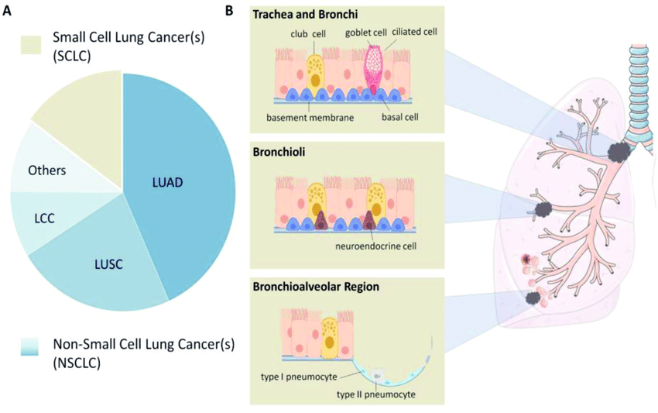
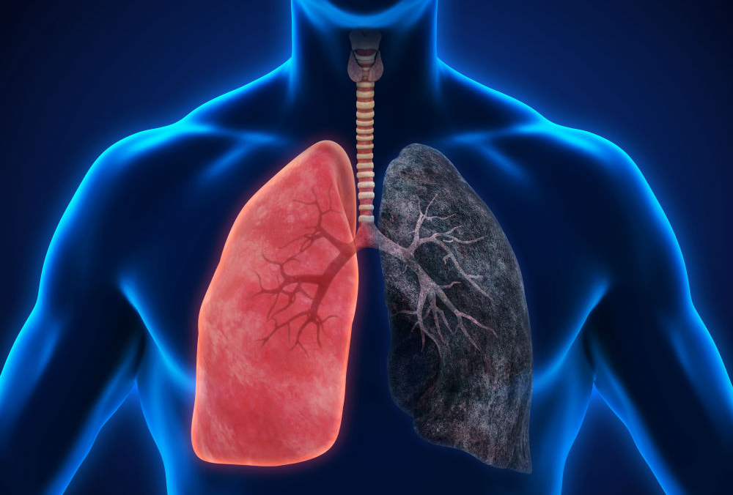

Respiratory and Lung Cancer
About 2 out of 3 people diagnosed with lung cancer are 65 or older.
Chances that women would develop lung cancer is 1 in 16.
An average of 181 women die each day of lung cancer.
Information Source:
https://www.mayoclinic.org/diseases-conditions/lung-cancer/symptoms-causes/syc-20374620
https://lungcanceralliance.org/advocacy/our-legislative-priorities/women-and-lung-cancer-research-and-preventive-services-act/women-and-lung-cancer-facts/
Notes:
The inhalation of certain chemicals, such as asbestos, nickel, and arsenic, are common causes of respiratory and lung cancers. Smoking also causes a major risk of developing these types of cancers because of the repeated inhalation of toxic chemicals.

Slide 8
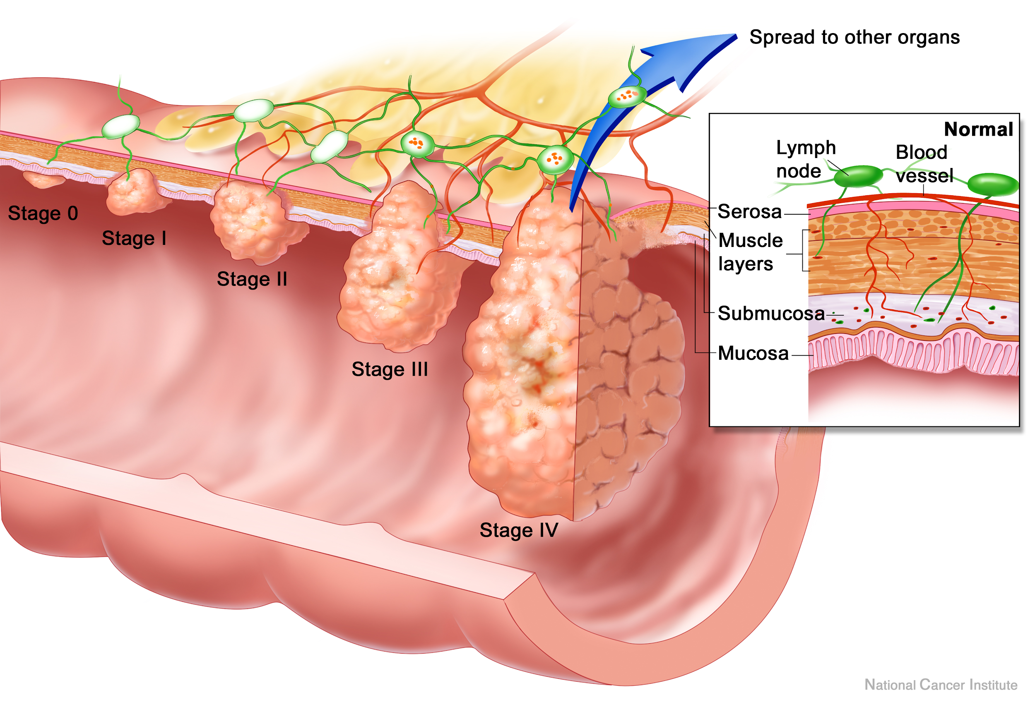


Digestive System Cancer
Includes cancer of the esophagus, gallbladder & biliary tract, liver, pancreas, stomach, small intestine, bowel (large intestine or colon and rectum), and anus.
Gastro-Intestinal (GI) cancer is the term that is used to describe the group of cancers that affect the digestive system.
Information Source:
https://www.healthline.com/health/gastric-cancer
Notes:
The next set of cancers are still high, but have a relatively more moderate rate than breast cancer. The digestive system, respiratory system, lung and bronchus, and genital system cancers all have clearly impacted over 100,000 women’s lives with digestive system cancer reaching nearly 150,000 ladies.
One way that digestive cancer often pops up is because of the contraction of H. pylori bacterial infections which causes ulcers then sometimes cancerous tumors. Smoking, poor diet, alcohol abuse, and lack of exercise are all factors that increase the likelihood of developing a kind of digestive cancer.

Slide 9

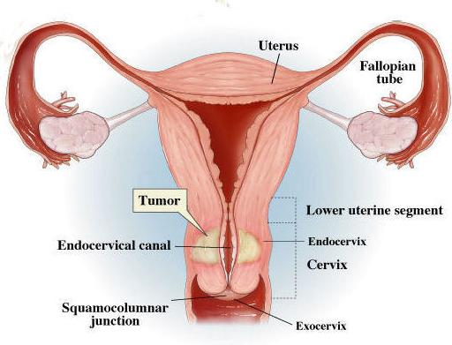
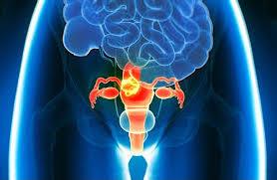

Genital Cancer
Five main types of cancer affect a woman's reproductive organs are cervical, ovarian, uterine, vaginal and vulvar.
The five gynecologic cancers begin in different places within a woman's pelvis; each is unique, with different signs and symptoms, different risk factors, and different prevention strategies.
Information Source: https://www.mayoclinic.org/diseases-conditions/vaginal-cancer/symptoms-causes/syc-20352447
https://www.cancer.northwestern.edu/types-of-cancer/gynecologic/index.html
Notes:
Now, this is not the only cause, but many female reproductive cancers are caused by HPV, a sexually transmitted disease. So, that would make sense as to why there are so many cases of it.

Slide 10

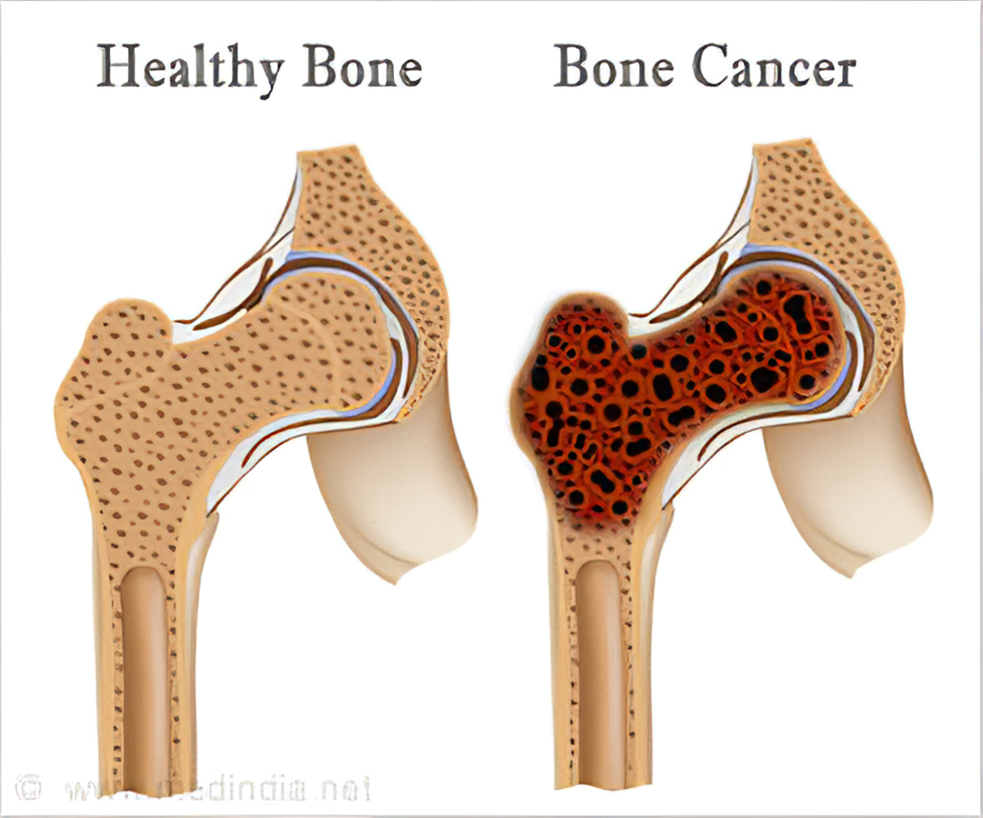
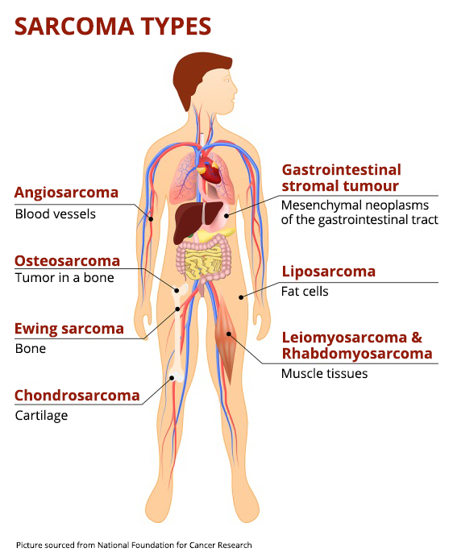

Other Cancers
There are over 300 different cancers found in women with 198 of them being rare.
139.6 out of every 100,000 women have cancer.
All cancers found in teens and children are considered rare cancers.
Information Source:
https://www.mayoclinic.org/diseases-conditions/bone-cancer/symptoms-causes/syc-20350217
https://www.cancer.org/cancer/soft-tissue-sarcoma/causes-risks-prevention/what-causes.html
https://www.cancerresearchuk.org/about-cancer/eye-cancer/risks-causes
https://www.cancer.gov/about-cancer/understanding/statistics
Notes:
With 45 different types of cancers mentioned, a majority of them only have a few thousand cases each year. Most of these are very specific organs that research only shows genetics and hereditary to blame or exposure to specific chemicals as the cause. These are harder for someone to develop, but are still a problem.

Slide 11
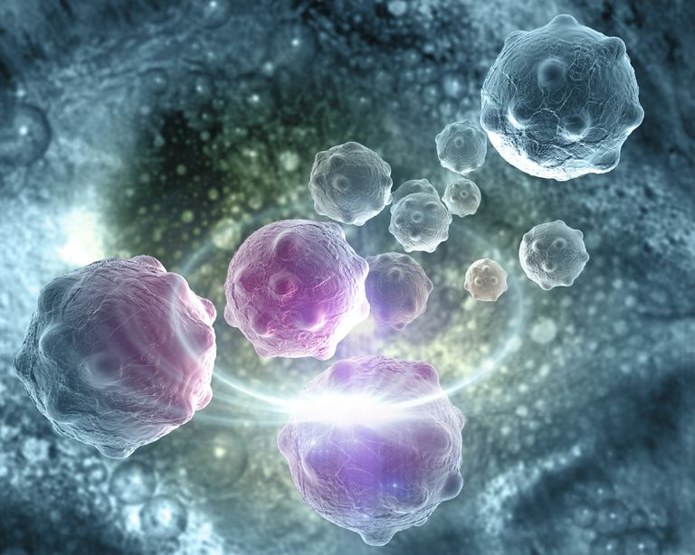




Slide 12
Questions?

Slide 13
Sources
Data source: American Cancer Society
Torre, Lindsey A., et al. “Global Cancer in Women: Burden and Trends.” Cancer Epidemiology, Biomarkers & Prevention, American Association for Cancer Research, 1 Apr. 2017, cebp.aacrjournals.org/content/26/4/444.
“U.S. Breast Cancer Statistics.” Breastcancer.org, 13 Feb. 2019, www.breastcancer.org/symptoms/understand_bc/statistics.
breastcancer.org. “Genetics: Breast Cancer Risk Factors.” Breastcancer.org, 30 July 2019, www.breastcancer.org/risk/factors/genetics.
“What Is Gastro-Intestinal (GI) Cancer?: GI Cancer Explained.” GI Cancer, gicancer.org.au/gi-cancer-explained/.
“Gynecologic Cancers.” Home: Robert H. Lurie Comprehensive Cancer Center of Northwestern University : Feinberg School of Medicine: Northwestern University, www.cancer.northwestern.edu/types-of-cancer/gynecologic/index.html.
“Women and Lung Cancer Facts.” Lung Cancer Alliance, 10 July 2019, lungcanceralliance.org/advocacy/our-legislative-priorities/women-and-lung-cancer-research-and-preventive-services-act/women-and-lung-cancer-facts/.
breastcancer.org. “Genetics: Breast Cancer Risk Factors.” Breastcancer.org, 30 July 2019, www.breastcancer.org/risk/factors/genetics.
breastcancer.org. “Personal History of Breast Cancer.” Breastcancer.org, 9 Sept. 2016, www.breastcancer.org/risk/factors/personal_history.
breastcancer.org. “Using HRT (Hormone Replacement Therapy).” Breastcancer.org, 10 Nov. 2017, www.breastcancer.org/risk/factors/hrt.
DePolo, Jamie. “Breast Surgeons Group Says Everyone Diagnosed With Breast Cancer Should Be Offered Genetic Testing.” Breastcancer.org, 15 May 2019, www.breastcancer.org/research-news/all-dx-w-bc-should-be-offered-genetic-testing.

